Slide 1

ADTA 5130 Flight Price Prediction
Project Presentation Group 3C
Team Members:
1. Deepeka Gurunathan
2. Kavivarshini Kandhasami
3. Srilakshmi Ragha Nikhitha Savithena
4. Sai Swetha Annem
5. Vaishnavi Govind Bhamare

Slide 2



Problem Statement
Inconsistent Pricing
Lack of Transparency
Limited Predictability
Flight prices can vary greatly, making it challenging to find the best deals. This leads to uncertainty and frustration for travelers.
Factors influencing flight pricing are often opaque, making it difficult to understand the cost fluctuations.
Predicting flight price changes is crucial for informed booking decisions, but existing methods are often inaccurate or unreliable.

Slide 3
WORKFLOW
1
Data Understanding
2
Exploratory Data Analysis
3
Hypotheses
4
Modeling
5
Conclusion

Slide 4

Data Understanding
10,000
10
Flight Records
Airlines
The dataset contains over
10,000 flight booking
records.
It has about 10 airlines
22
3
Columns
Years
It has 22 variables
It contains 3 years data

Slide 5
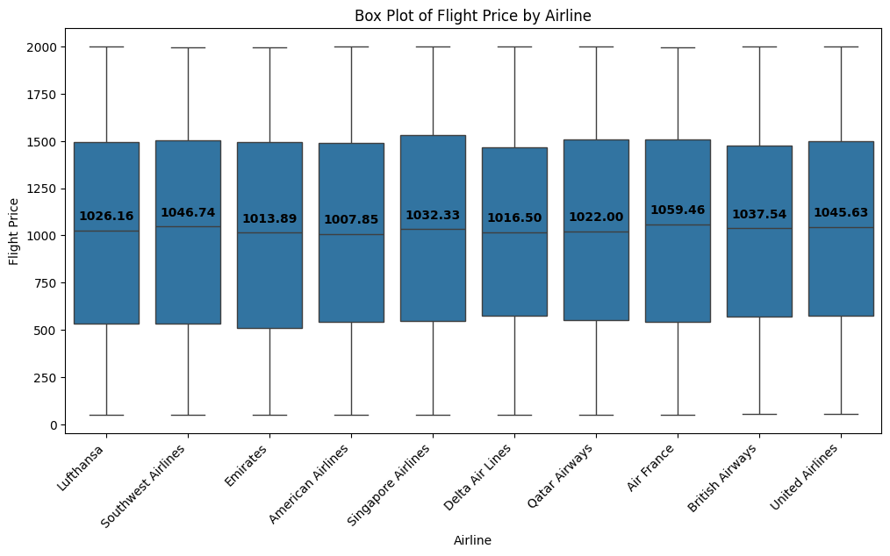

Exploratory Data Analysis – Flight Price and Airline
Observations: The flight price has been consistent across all the airlines.
We could also confirm that there are no outliers in flight prices.

Slide 6
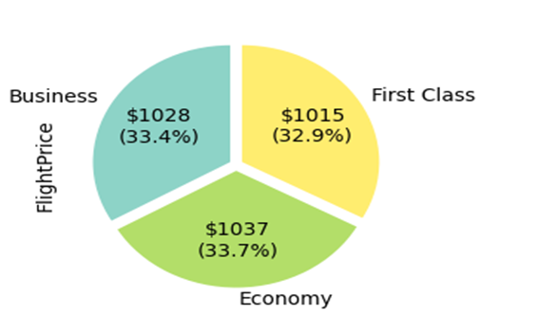
Exploratory Data Analysis – Class Type
Observations:​ ​ The flight price is
slightly higher for the
Economy than other classes which may be due to large
amounts of data from the
economy class present in the dataset.
​

Slide 7
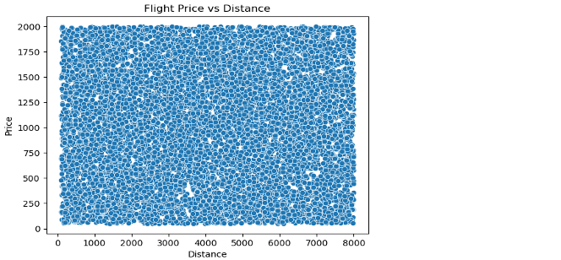
Exploratory Data Analysis – Flight Price and Distance
Observations:​​ ​​ We could see that there is no
relationship between the two
variables
There must be some other
factors influencing the flight
price along with the distance

Slide 8
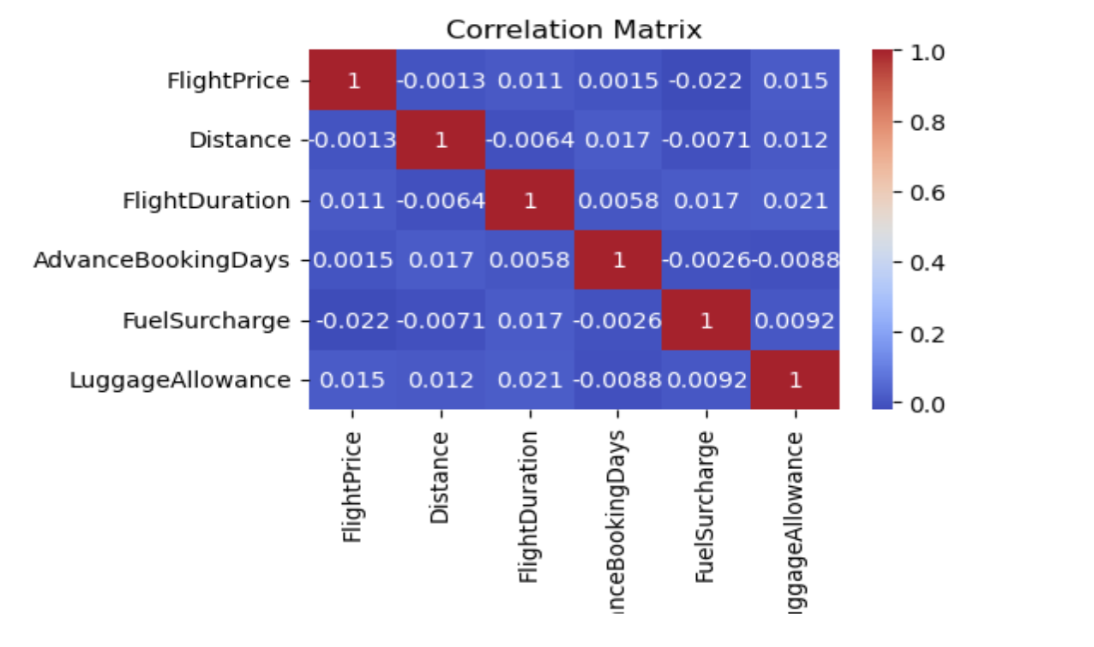
Exploratory Data Analysis- Correlation Matrix
Observations:​​​ ​​​ There is a slight positive
correlation between Luggage
Allowance and Flight Price.
There is no relationship
between flight price and
distance

Slide 9
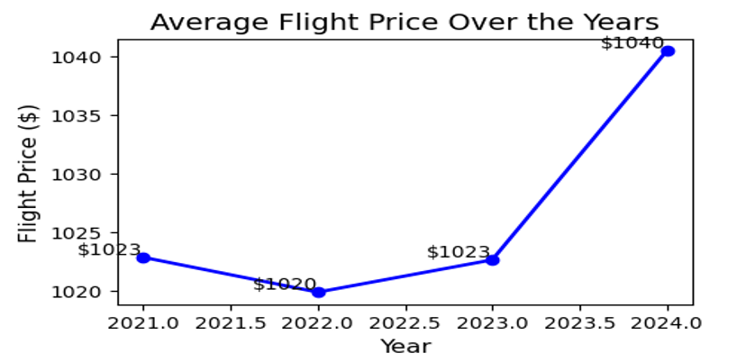
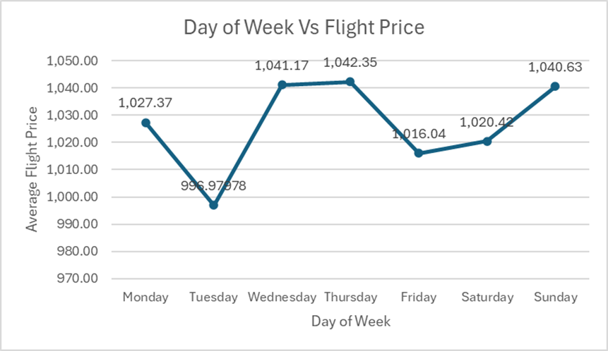
Exploratory Data Analysis – Time Series Data
Observations:​​​ ​​​ We could see flight prices started drastically increasing from 2023
​
We could see the prices are high on Sunday, Wednesdays, and Thursdays,
compared to the other days.

Slide 10

Hypothesis
1
Flight Duration
5
Holiday Period
Shorter distance may result in lower ticket prices due to lower demand.
Holiday period might be associated with higher ticket prices, reflecting increased travel demand.
2
Airlines
6
Advance Booking Days
Flight prices vary from airlines to airlines due to several factors such as comfort, entertainment, and etc.
Advance Booking days is one of the prime factors in deciding the flight price.
3
Distance
7
Fuel Surcharge
Shorter distance may result in lower ticket prices due to lower demand.
Fuel Surcharge might be associated with higher ticket prices.
1​
​
4
Luggage Allowance
8
Seat Availability
Flights with extra luggage allowance are expected to have higher prices in international routes.
Seat Availability may impact the price, the fewer the seats, the higher the price.

Slide 11
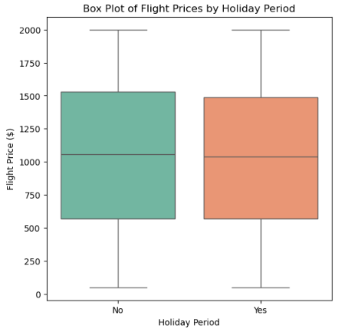
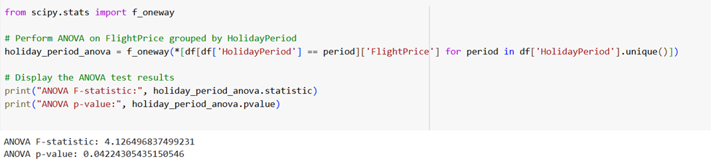
Modeling
Analysis of Variance – Holiday Period
We performed a one-way ANOVA to investigate the effects of the holiday period on flight prices. ANOVA tests the null hypothesis and confirms that there is a statistically significant difference exist between the means of groups.
0.04
4.12
P-value
F-statistic
The ANOVA results indicated a significant difference in average flight prices during holiday days, suggesting that holiday days does impact ticket costs.

Slide 12
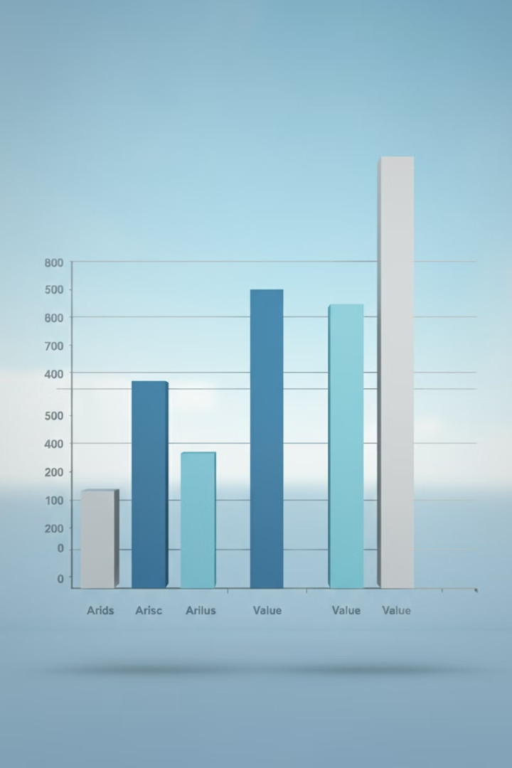
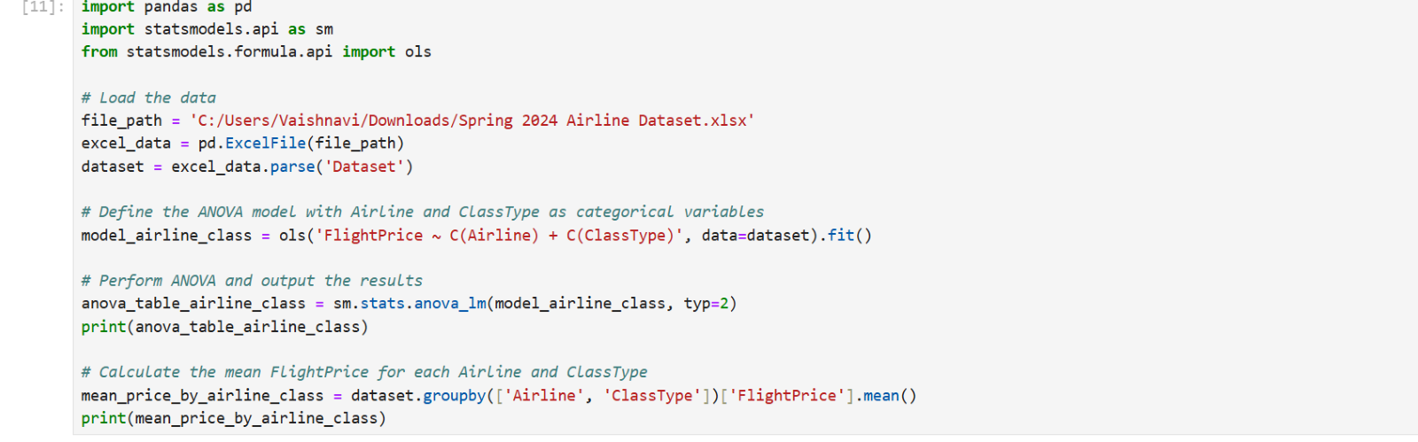
Two- Way ANOVA
We performed a two-way ANOVA to investigate the airline and class type against flight prices. ANOVA tests the null hypothesis that there is no significant difference between the means of groups.
0.99
0.254
P-value
F-statistic
The ANOVA results indicated that there is no significant difference in average flight prices with respect to airlines and class types, suggesting these factors do not impact ticket prices.

Slide 13
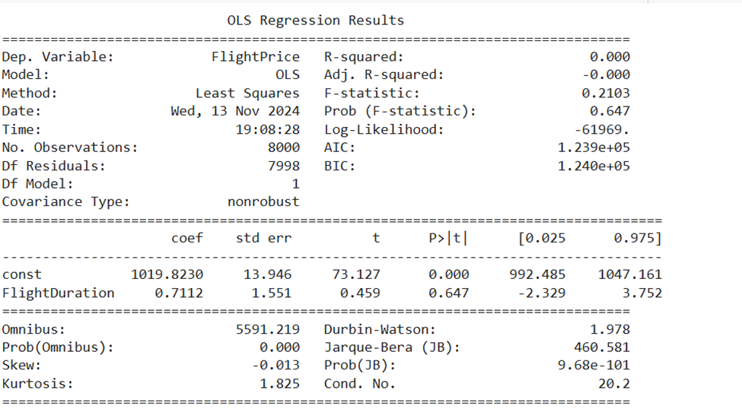
Regression Analysis – Simple Linear Regression
Regression analysis is a statistical method used to predict the relationship between variables. It helps us understand how changes in one variable (independent) affect another (dependent) variable.
Simple Linear Regression with Duration and Flight Price
R-squared (0.000): R-squared shows that Flight Duration explains none of the
variance in Flight Price.
Adjusted R-squared (-0.000): Even after
adjusting for the number of predictors, the model has no explanatory power for
predicting Flight Prices.
F-statistic (0.2103, p = 0.647): The low
F-statistic and its high p-value
indicate that the model is not statistically significant, and Flight Duration
does not contribute meaningfully to
predicting flight Prices.

Slide 14
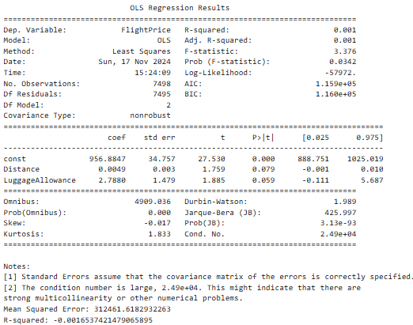
Regression Analysis – Multiple Linear Regression
Multiple Regression analysis is a statistical method used to predict the relationship between a dependent variable and two or more independent variables.
Multiple Linear Regression with Distance, Luggage Allowance and Flight Price
R-squared = 0.001: The model explains 0.1% of the variance in Flight Price,
which is very low. This indicates that
Distance and Luggage Allowances are
weak predictors of flight prices.
Adjusted R-squared = 0.001: After
adjusting for the number of predictors, the model's explanatory power remains negligible.
F-statistic = 3.376 (p-value = 0.0342): The model is statistically significant at 5% (p < 0.05).
This suggests that at least one of the predictors has a weak but statistically significant relationship with Flight
Price.

Slide 15

Conclusion
Key Findings:
The overall analysis reveals the holiday period, fuel surcharge, and luggage allowance are the most influential factors.
Adding additional variables to the dataset and combining advanced modeling techniques could provide better predictive accuracy.
Recommendations:
Improved Feature Engineering - Include more variables that may impact prices, such as fuel prices, demand by passengers, and route popularity.
Sophisticated Modeling Techniques - Employ other machine learning models, such as decision trees and random forests, which may capture any nonlinear relationship. Use clustering techniques to determine price patterns for particular routes.

Slide 16
THANK YOU!!

